Slide 1


Introduction to Research Data Management
Joy Davidson
Digital Curation Centre

Slide 2
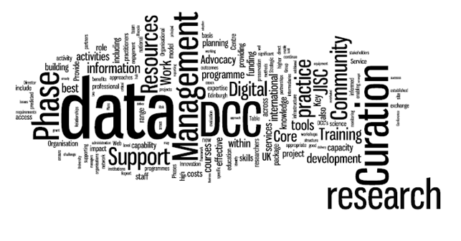

The Digital Curation Centre
“Helping to build capacity, capability and skills in data management and curation across the UK’s higher education research community”
www.dcc.ac.uk
Notes:
Jisc-funded consortium comprising units from the:
Universities of Bath (UKOLN)
Edinburgh (DCC Centre)
Glasgow (HATII)
Launched 1st March 2004 as a national centre for solving challenges in digital curation that could not be tackled by any single institution or discipline

Slide 3
Data Management Planning
Research Data Management Landscape
Data Management Planning

Slide 4
What is data curation?
“the active management and appraisal of data
over the lifecycle of scholarly and scientific interest”
Data have importance as the evidential base
of scholarly conclusions
Curation is part of good research practice

Slide 5
What does research data management involve?
Data Management Planning
Creating data
Documenting data
Accessing / using data
Storage and backup
Sharing data
Preserving data
Create
Document
Use
Share
Preserve
Store
Notes:
Broadly speaking research data is collected, recorded, processed and results are published.
The management of research data will involve different combinations of researchers and support staff and activities during different stages of your research. The research data lifecycle reflects how your research data has been managed at each stage in the research lifecycle.
Leeds bre3akdown of responsibilities:
PI / Responsible Data Owner responsibilities during the project/programme lifetime - this will include the writing of the data management plan as the proposal is developed, ensuring that the plan is followed, and making the data and associated contextual information available for deposit at the end of the project. It is expected that all members of the research team will be engaged in the data management activities with support and infrastructure coordinated at the University level.
PI / Responsible Data Owner responsibilities beyond the project/programme lifetime - beyond the life of the project it is expected that the University or repository will be responsible for the management of the data. The value of research data may not always be fully appreciated during the project and may change over time beyond the life of the project. Decisions about the long term storage and preservation of data may have to be reviewed where the importance of the research changes over time. While the PI may be available to help with such decisions it will be the responsibility of the University or repository to ensure that the agreed management is undertaken.

Slide 6
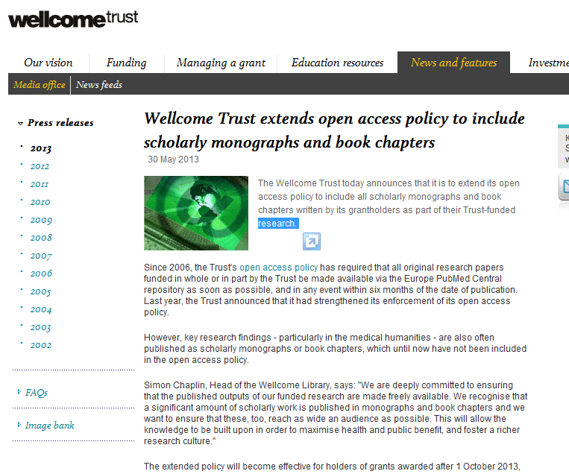
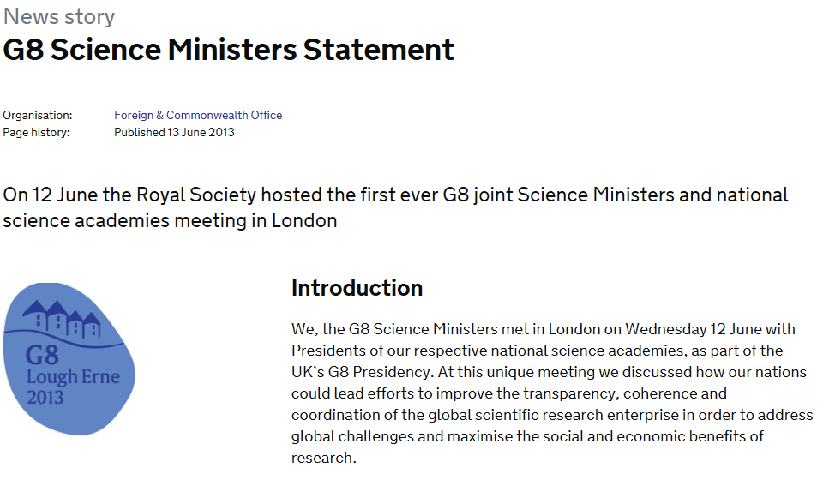



‘Conducting research on existing data sets less expensive than setting up new studies and novel linkage can widen focus’
Dr Jim Lewsey, Statistical Analysis of Linked Health Data (SALHDa), Launch of HEHTA
Why does RDM matter?
https://www.gov.uk/government/news/g8-science-ministers-statement
Notes:
Why are RDM and data sharing now such big issues?
‘Publicly funded research data are a public good, produced in the public interest, which should be made openly available with as few restrictions as possible in a timely and responsible manner that does not harm intellectual property.’
RCUK Common Principles on Data Policy http://www.rcuk.ac.uk/research/Pages/DataPolicy.aspx
RCUK OA policy revised in 2012 to require a statement in published papers on how to access the underlying data.
Wellcome Trust has recently extended the OA mandate to include monographs as well as articles.
AllTrials is working to make clinical trial data more accessible and has support from the majority of funding bodies.
G8 Science Ministers statement in June 2013, open data is a key goal.
‘To the greatest extent and with the fewest constraints possible publicly funded scientific research data should be open, while at the same time respecting concerns in relation to privacy, safety, security and commercial interests, whilst acknowledging the legitimate concerns of private partners.’
Here in Glasgow University, there is also recognition that sharing data can reduce costs and increase potential for novel research. Health Economics and Health Technology Assessment (HEHTA) was launched in March 2012.

Slide 7
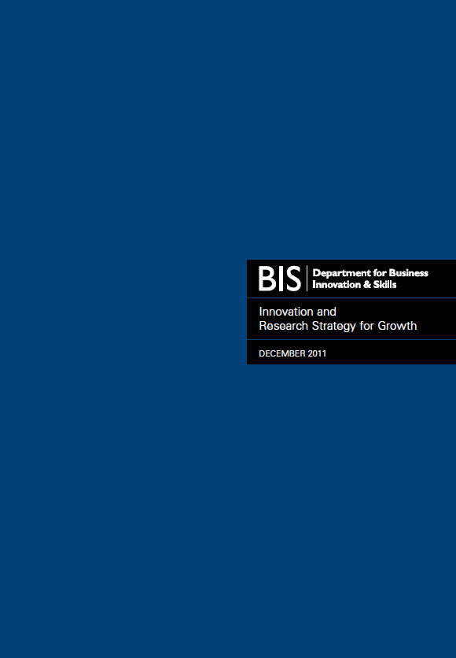

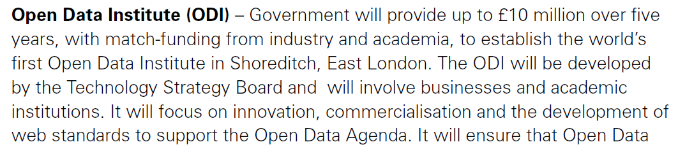

…open data
http://www.bis.gov.uk/innovatingforgrowth
Notes:
Government keen to promote open access to data.
7

Slide 8
About this course
Short presentations with exercises and discussion
Research Data Management Landscape
Introduction to Data Sharing and Data Management Planning
Data sharing exercise
DMPonline demonstration
Lunch

Slide 9

“Data sets are becoming the new instruments of science”
Dan Atkins, University of Michigan

Slide 10

Digital data as the new special collections?
Sayeed Choudhury, Johns Hopkins

Slide 11
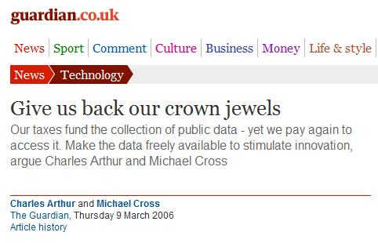

Research data: institutional crown jewels?
http://www.flickr.com/photos/lifes__too_short__to__drink__cheap__wine/4754234186/

Slide 12
Exceptions to copyright
*Reforms to copyright law come into force on 1st June*
The exceptions coming into force today will bring a range of benefits to a wide range of groups:
Researchers will benefit from the introduction of the new text and data mining exception for non-commercial research, as well as the reforms to existing
Libraries, archives and museums will now be better able to protect our cultural heritage and preserve their collections. The existing preservation exception has been expanded to cover all types of copyright work, and now applies to museums and galleries as well as libraries and archives.

Slide 13

Funders’ expectations of public access
“Publicly funded research data are a public good, produced in the public interest, which should be made openly available with as few restrictions as possible in a timely and responsible manner that does not harm intellectual property.”
RCUK Common Principles on Data Policy
http://www.rcuk.ac.uk/research/Pages/DataPolicy.aspx

Slide 14
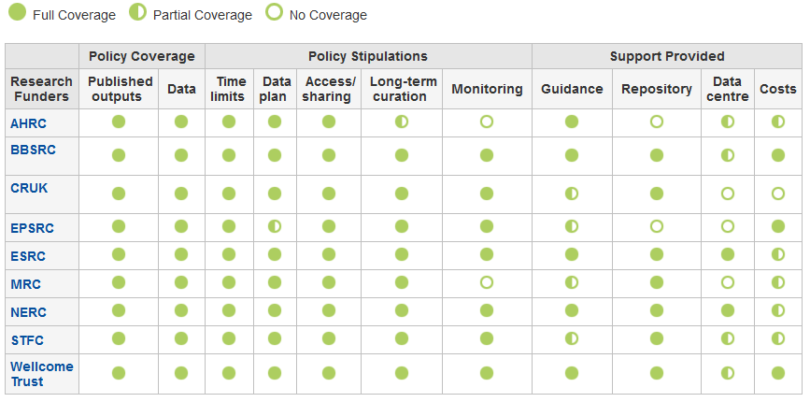
Research funder data policies
www.dcc.ac.uk/resources/policy-and-legal/ overview-funders-data-policies

Slide 15

Ultimately funders expect:
timely release of data
  once patents are filed or on (acceptance for) publication
open data sharing
  minimal or no restrictions if possible
preservation of data
  typically 5-10+ years if of long-term value
See the RCUK Common Principles on Data Policy:
www.rcuk.ac.uk/research/Pages/DataPolicy.aspx

Slide 16

“Research organisations will ensure that effective data curation is provided throughout the full data lifecycle, with ‘data curation’ and ‘data lifecycle’ being as defined by the Digital Curation Centre. The full range of responsibilities associated with data curation over the data lifecycle will be clearly allocated...”
...institutional responsibility
www.epsrc.ac.uk/about/standards/researchdata/Pages/expectations.aspx

Slide 17
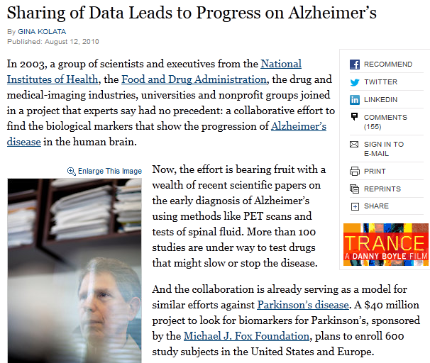
Benefits of data sharing (1)
“It was unbelievable. Its not science the way most of us have practiced in our careers. But we all realised that we would never get biomarkers unless all of us parked our egos and intellectual property noses outside the door and agreed that all of our data would be public immediately.”
Dr John Trojanowski, University of Pennsylvania
www.nytimes.com/2010/08/13/health/research/13alzheimer.html?pagewanted=all&_r=0
    ... scientific breakthroughs

Slide 18
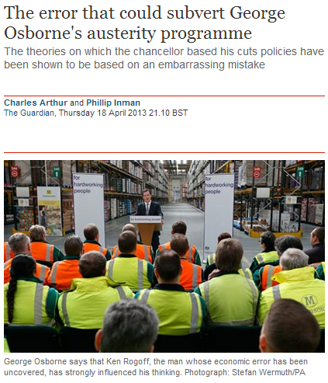
Benefits of data sharing (2)
“It was a mistake in a spreadsheet that could have been easily overlooked: a few rows left out of an equation to average the values in a column.
The spreadsheet was used to draw the conclusion of an influential 2010 economics paper: that public debt of more than 90% of GDP slows down growth. This conclusion was later cited by the International Monetary Fund and the UK Treasury to justify programmes of austerity that have arguably led to riots, poverty and lost jobs.”
    ... validation of results
www.guardian.co.uk/politics/2013/apr/18/uncovered-error-george-osborne-austerity

Slide 19

Benefits of data sharing (3)
“There is evidence that studies that make their data available do indeed receive more citations than similar studies that do not.”
Piwowar H. and Vision T.J 2013 "Data reuse and the open data citation advantage“ https://peerj.com/preprints/1.pdf
... more citations
9% - 30% increase

Slide 20
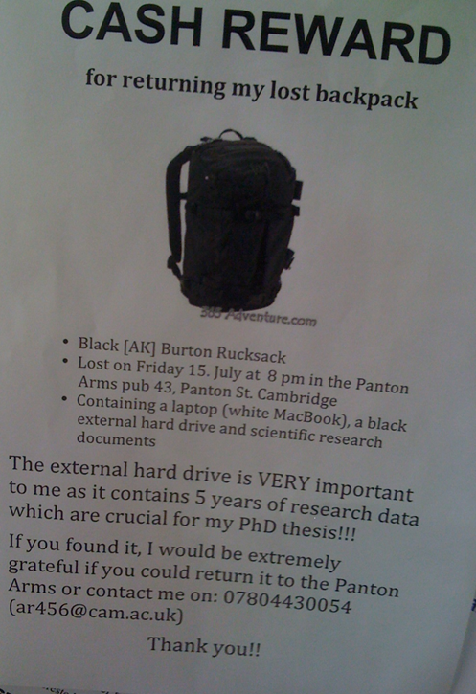
Direct benefits to individuals
Why YOU need a Data Management Plan
http://blogs.ch.cam.ac.uk/pmr/2011/08/01/why-you-need-a-data-management-plan

Slide 21
Data Management Planning
Research Data Management Costs
Data Management Planning

Slide 22
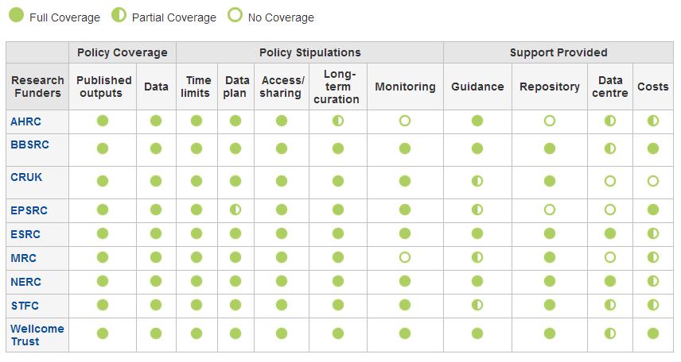
Research funders’ policies
www.dcc.ac.uk/resources/policy-and-legal/overview-funders-data-policies

Slide 23
Key differences in policies
Preservation periods range from 3 years to in perpetuity
  most funders ask for 10+ years
ESRC and NERC may withhold the final grant payment if data aren’t offered for deposit
Cancer Research UK states explicitly that it will NOT provide additional funds for RDM

Slide 24
What RDM cost can be included?
Need to distinguish between the costs that are incurred during a project and those that arise afterwards.
In-project (direct) costs:
  covers hardware, staff, expenses, costs of preparing data & metadata...
Post project (largely indirect) costs:
  existing services should be used where possible
  where an institution is going to provide a data repository, costs should be met through FEC
  outsourcing to a third-party is also an option
Owing to its charity status, the Wellcome Trust in general only pays directly incurred costs.

Slide 25
How should costs be included?
In-project costs should be included in the direct costs for a project
Post-project costs could be direct (e.g. charges levied by data centres) but typically fall into indirects as universities should provide infrastructure to support RDM
The Justifications of Resources should, where possible, separate out the following RDM cost elements:
  cost of collecting data
  the cost of curating data
  the cost of analysing data
  the cost of preservation and sharing

Slide 26
Key messages
Research data management should not be regarded as optional.
DMPs should make clear what is provided and what activities are being charged against a grant
The cost of RDM is project-specific and entirely depends on the type of work.
It may be possible to set up small research facilities to recover the cost of RDM (e.g. similar to provision of HPC), possibly as a cross-institutional service.

